Slide 1


























Slide 2






Cyber Attack

Slide 3






Slide 4












Slide 5



Cyber Security is the technology and process that is designed to protect networks and devices from attack, damage, or unauthorized access.

Slide 6






Inspires customer confidence
Protection of your business
Increase productivity
Stops your website from crashing
Protection for your customers or clients

Slide 7










Slide 8

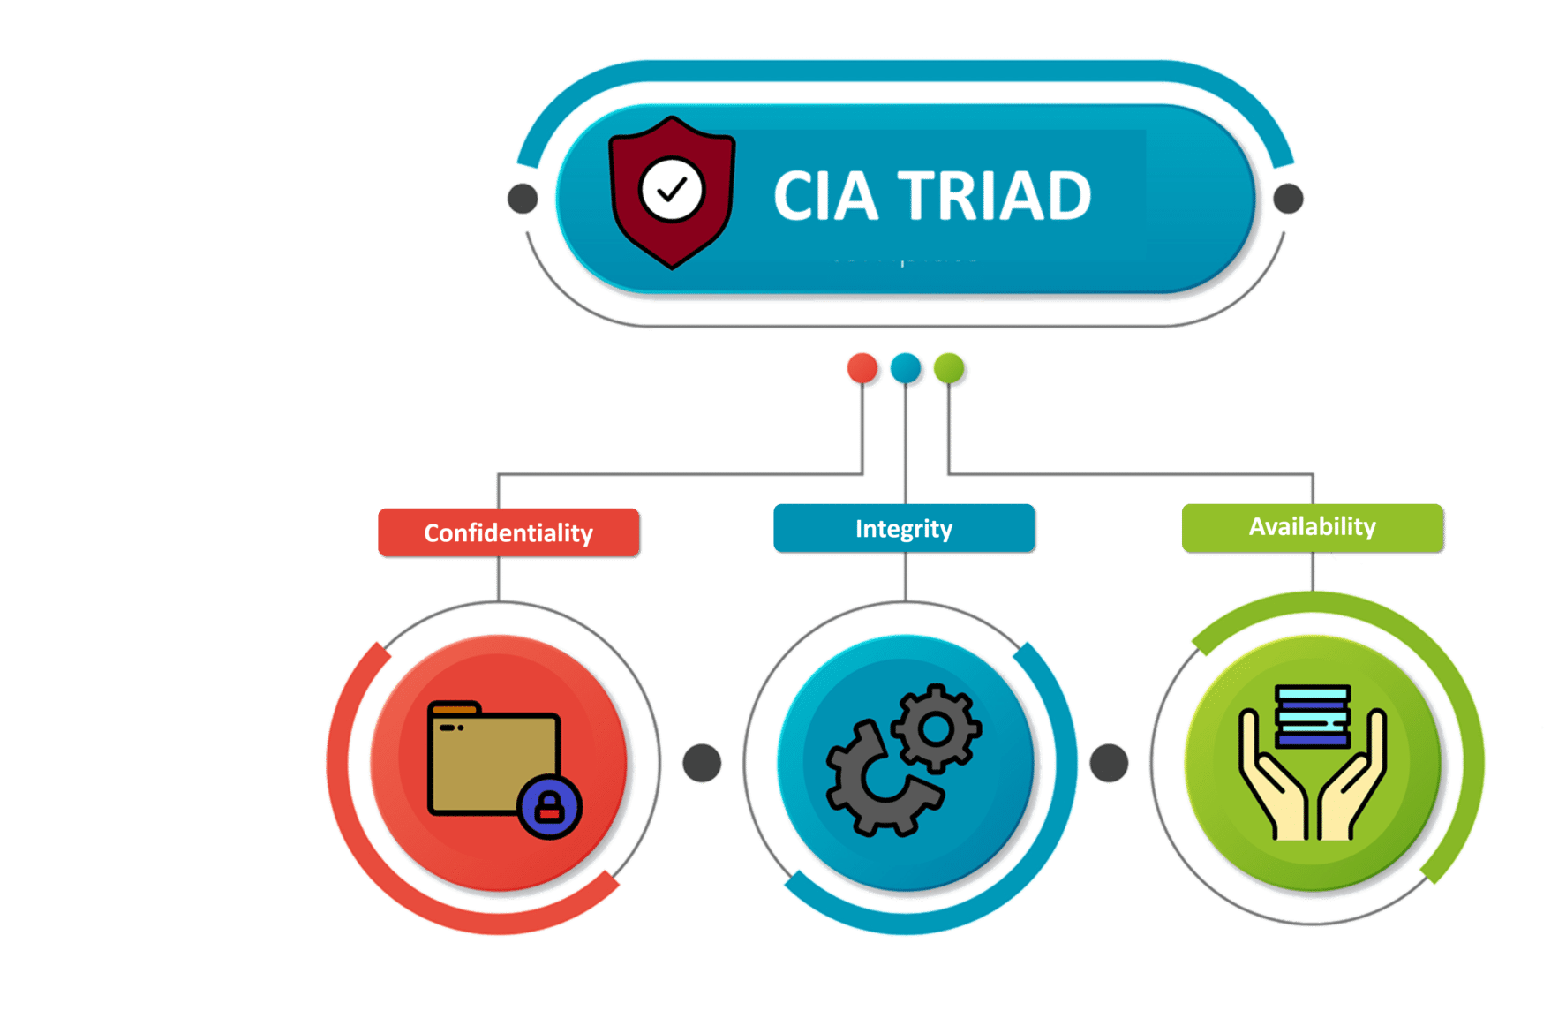

Confidentiality, Integrity, Availability
have served as the industry standard for Computer Security since the time of first mainframes.

Slide 9








Slide 10




Slide 11


The principles of confidentiality assert that information and functions can be added, altered, or removed only by authorized people & means.
The principles of confidentiality assert that information and functions can be accessed only by authorized parties.
Example: Incorrect data entered by a user in the database
Example: Military Secrets
The principles of availability assets that systems, functions, and data must be available on demand according to agreed-upon parameters based on levels of service.

Slide 12








Slide 13


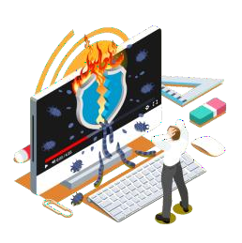


Cybercrime is any criminal activity that involves a computer, network device or a network
Cybercrime are carried out against computers or devices directly to damage or disable the, spread malware, steal secret information, etc.
Most Cybercrime are carried out in order to generate profit for the Cyber Criminals.

Slide 14













Slide 15










Fraud, Denial of Service (DOS)
Customer Sniffing, traffickers Viruses

Slide 16














Slide 17







Information theft & manipulating data
Disputing business
continuity
Damaging reputation of
the target
Achieving state’s military objectives
Financial loss to the target
Demanding ransom

Slide 18





Slide 19







WhiteHat Hacker
01
06
02
Script Kiddie
Black Hat Hacker
05
03
04
Hacktivist
Gray Hat Hacker
Red Hat Hacker

Slide 20









Slide 21
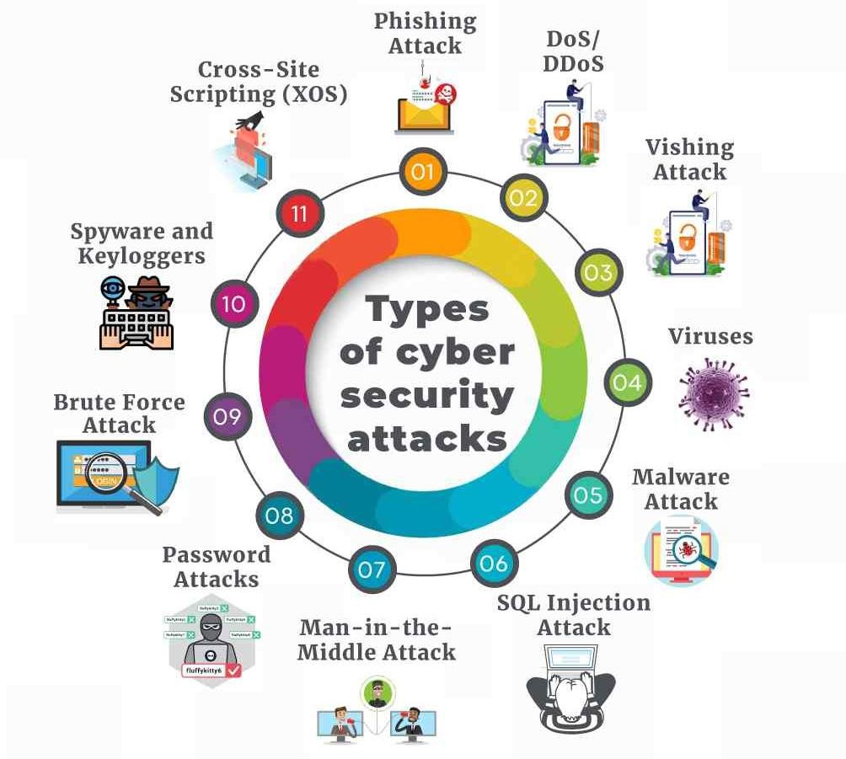


Slide 22









Slide 23
























Slide 24











Slide 25






















A Cyber Security expert is an individual employed by an organization to protect their data.

Slide 26



















Security Analyst
₹
Information Security Analyst
₹
Cyber Security Analyst
₹
Security Consultant, (Computing / Networking / IT)
₹
Technical
Consultant
₹
Ethical Hacker
₹
Network Security Engineer
₹
Security Manager, IT
₹
Chief Information Security Officer
₹

Slide 27
























Slide 28








Slide 29

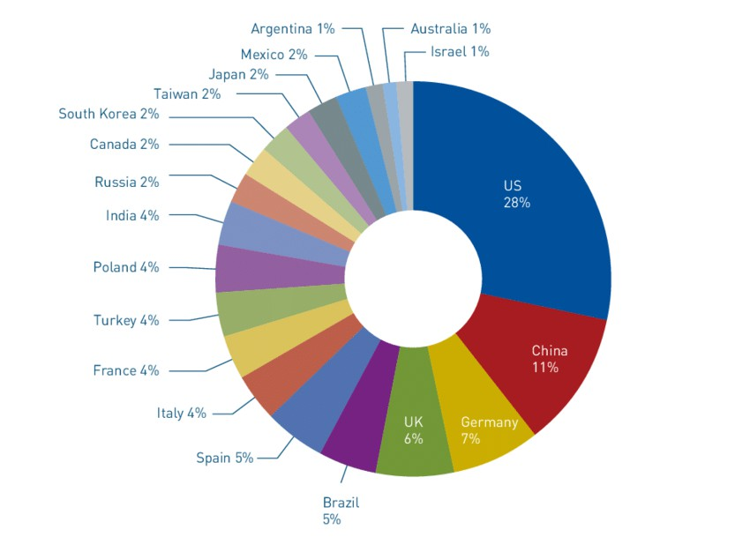


Slide 30









₹

Slide 31

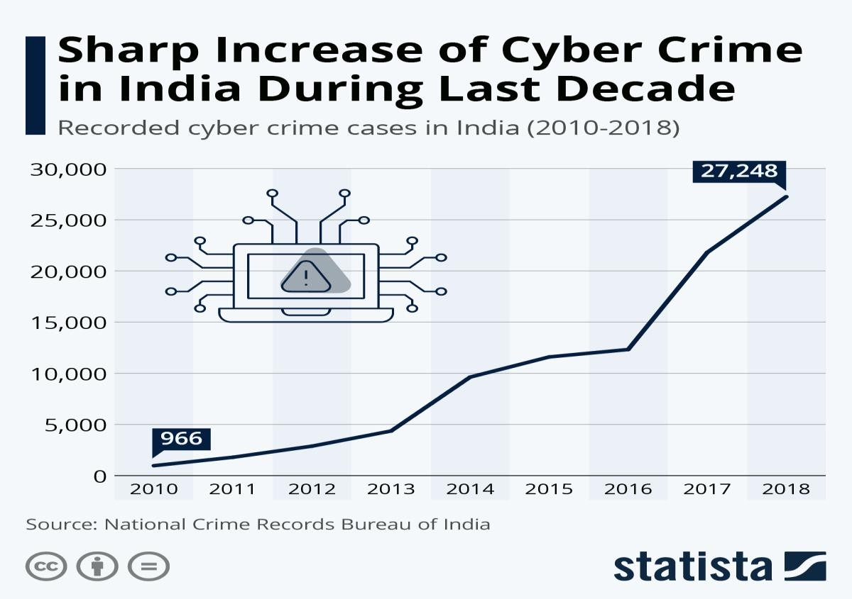


Slide 32

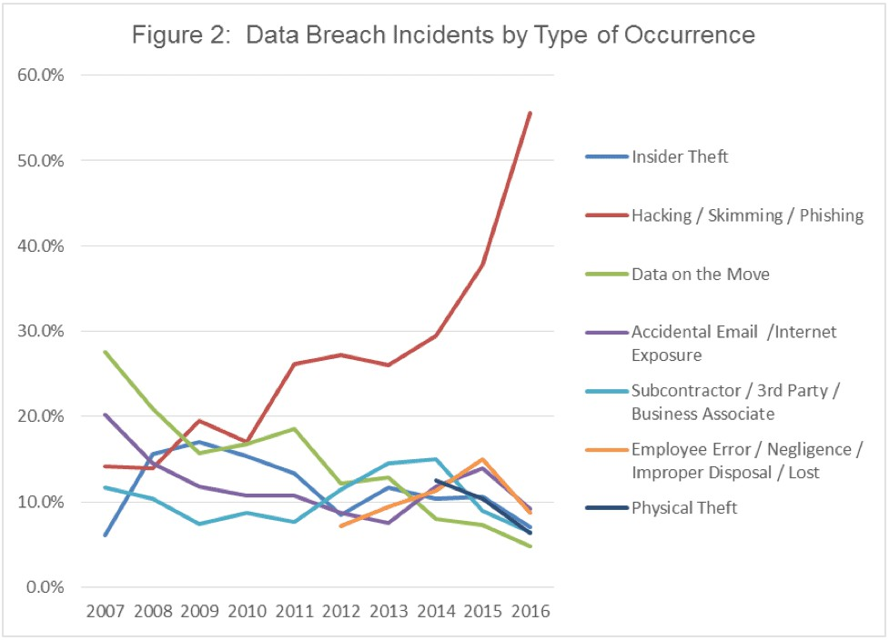


Slide 33


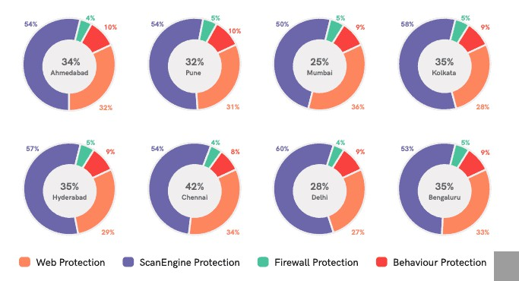


Slide 34



- Kali Linux

Slide 35




💣

